Slide 1
Leveraging OpenStreetMap to investigate urban accessibility and safety of visually impaired pedestrians
Achituv Cohen, Asya Natapov, Sagi Dalyot
Notes:
נושא המחקר
פסי ההכוונה
המסמרות המישושיות

Slide 2
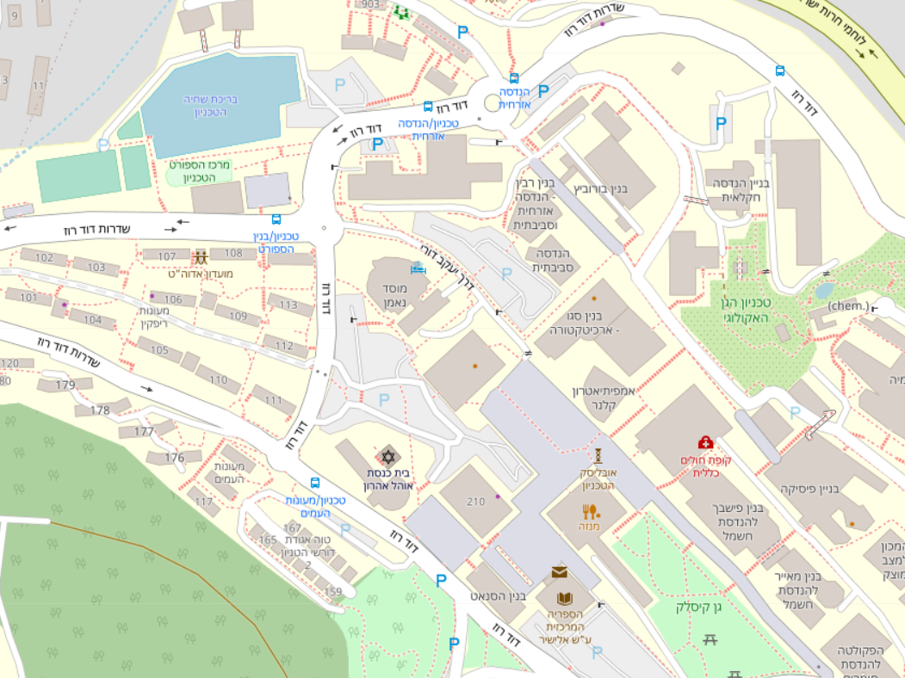
A
B
Notes:
inclusive

Slide 3
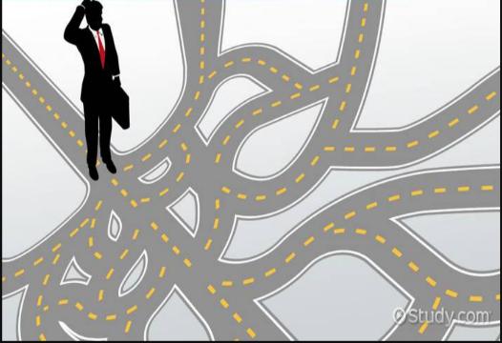
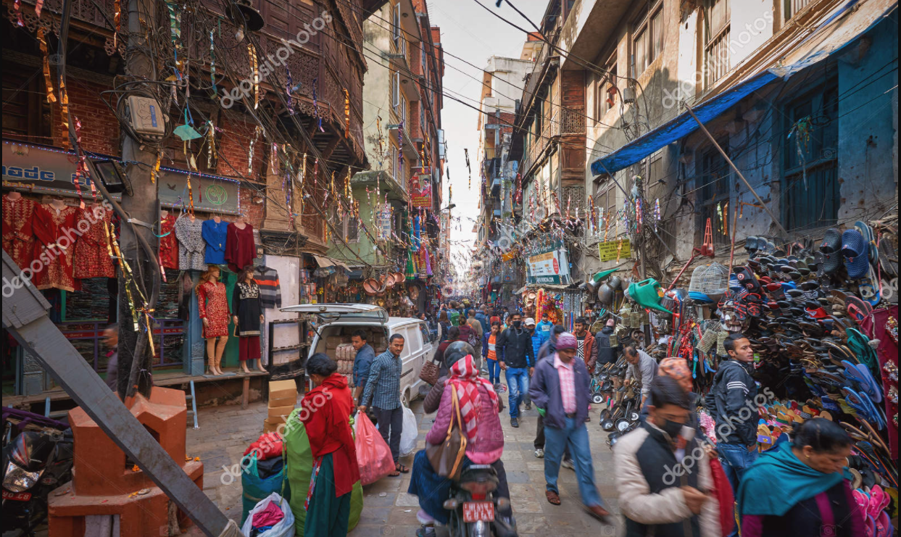
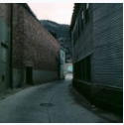
From Qualitative Insights to Criteria
Way Type
Landmarks
Complexity
Pedestrian Activity
Living Street
Service Road
Footway

Slide 4
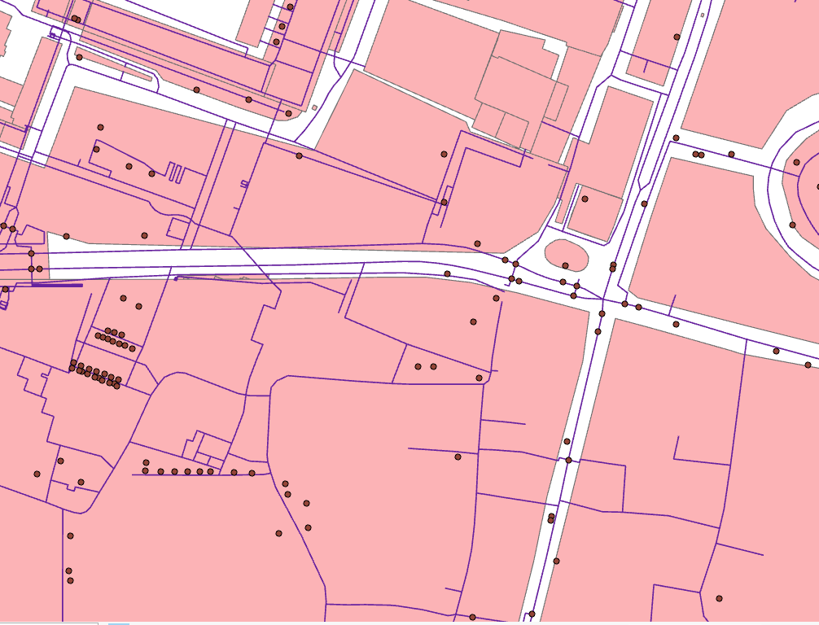
Criteria Implementation on the Street Network
1 | 2 | 3 | 4 | 5
Complexity
Landmarks
Weight$=e_{i}.c_{1}−\frac{e_{i}.c_{2}}{e_{i}.length}+\frac{e_{i}.c_{3}}{2π}$ + $\left\{\begin{matrix}1 & e_{i}.{\bar{c}}_{4}<1.5 \\ 2 & e_{i}.{\bar{c}}_{4}>2.5 \\ 0 & else\end{matrix}\right.$
Way Type
Pedestrian Activity

Slide 5
Calculating customized accessibility index

Slide 6
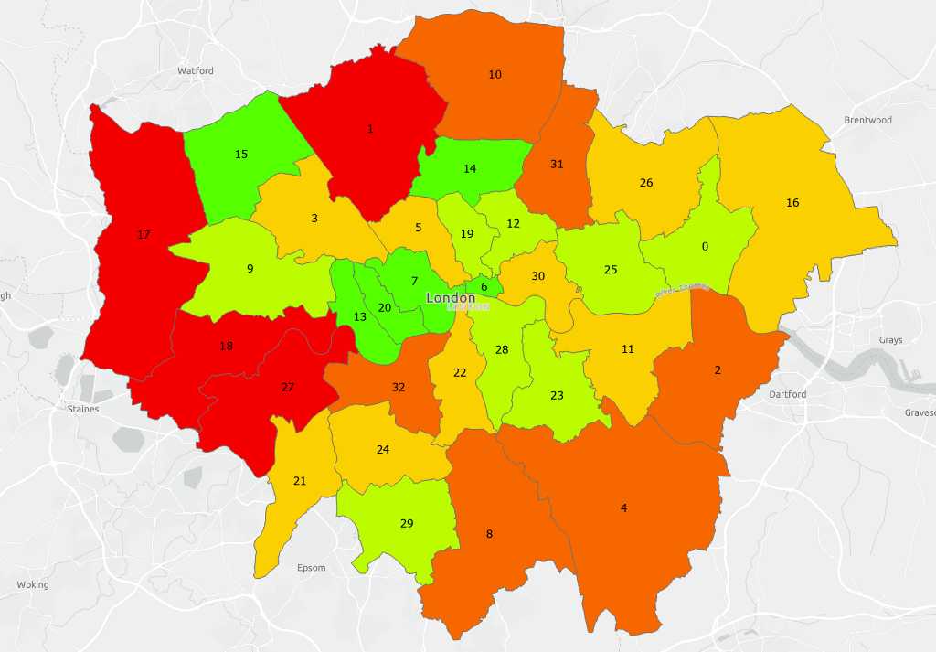
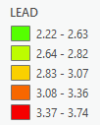
LEAD – visuaLly impairEd Accessibility inDex
LEAD classes (Natural Jenks) for all London boroughs from good accessibility (green) to medium accessibility (red).
Notes:
שטחים פתוחים ← אזורי מגורים ← אזורי מגורים

Slide 7
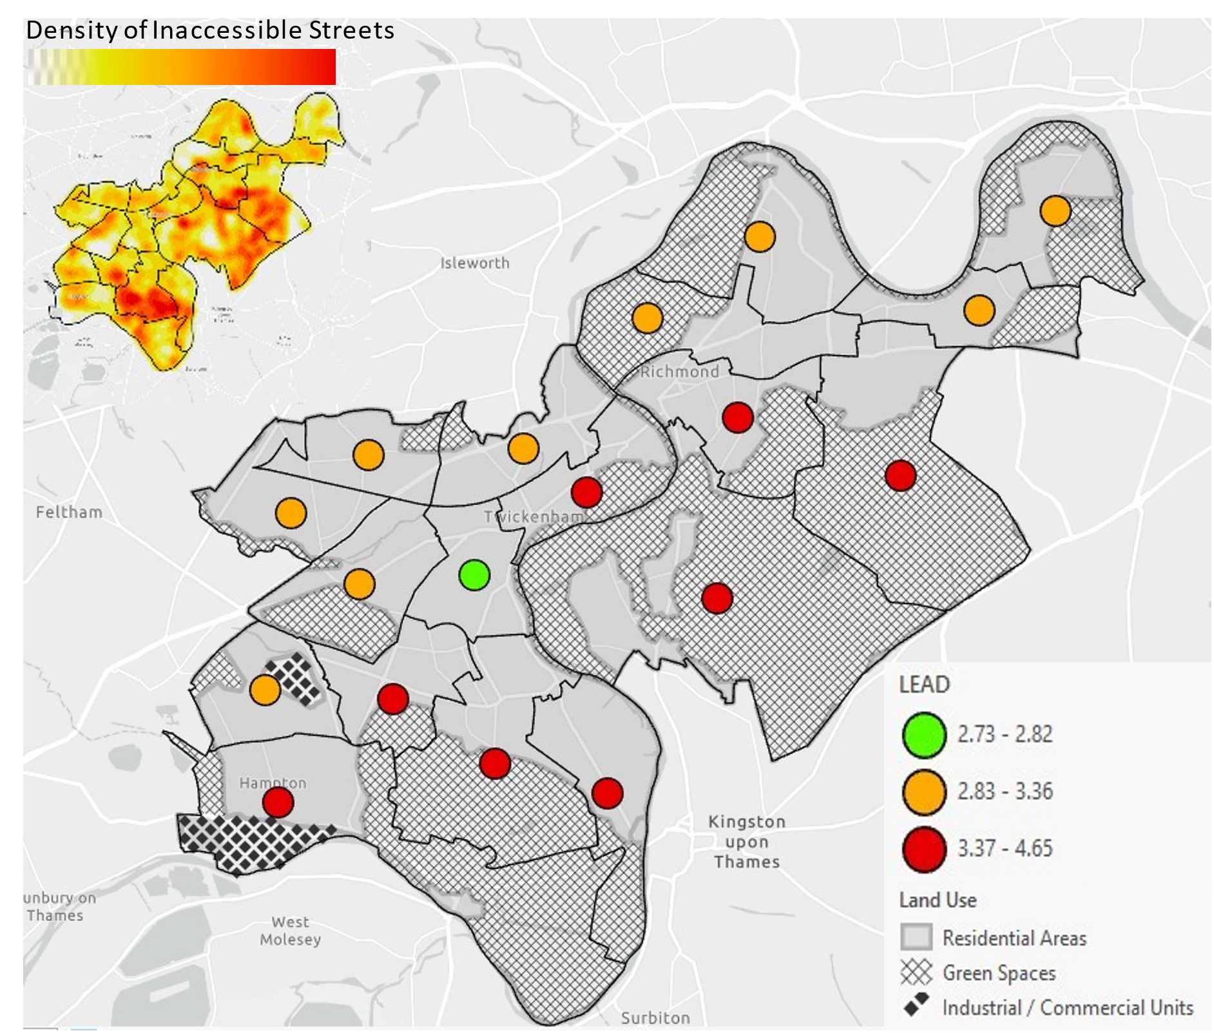
LEAD – visuaLly impairEd Accessibility inDex
Richmond upon Thames spatial extent and its wards' boundaries (black polygons). The spatial distribution of land uses, and wards’ LEAD values (denoted by colored circles).
Top-left - heat map of inaccessible street segments.
Notes:
שטחים פתוחים ← אזורי מגורים ← אזורי מגורים

