Slide 1
Investigating the capability of UAV imagery for AI-assisted mapping of Refugee Camps in East Africa
Lightning talk
Christopher Yan-Chak, Chan
Matthias Weigand
Emran Alchikh Alnajar
Dr. Hannes Taubenböck
2022-08-21

Slide 2
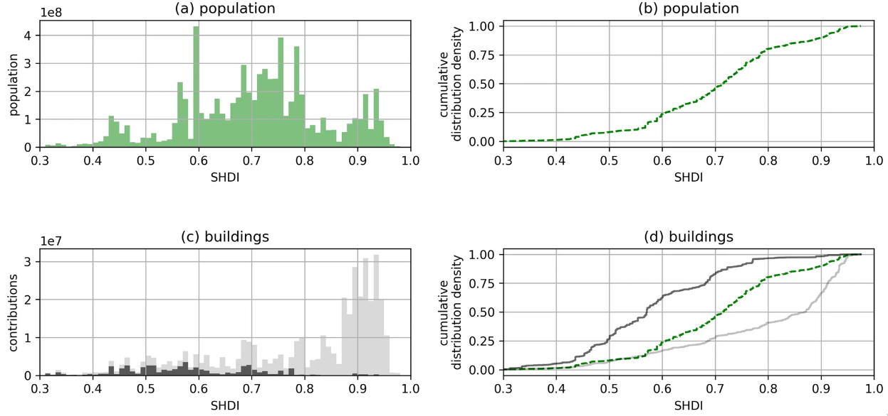
Problem
Informal settlement mapping is key catalyst to formalisation
Still highly neglected
Episodes of mapping activity dependent on natural disaster (Herfort et al., 2021)
Assisted mapping could help reduce data inequality

Slide 3
Objective
Use OpenAerialMap for building extraction in informal settlements
Compare existing models to the model trained in this study
Ensure Reproducibility through open-source code
Project extension capabilites for HOT community

Slide 4
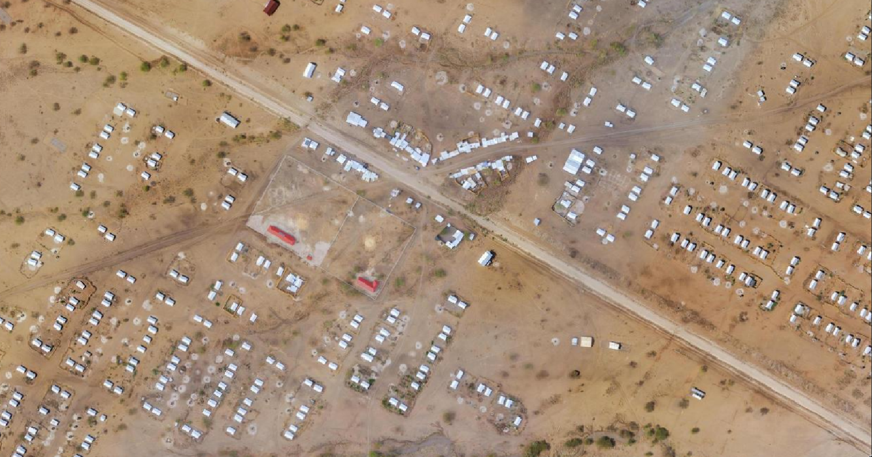
Kalobeyei, Kakuma, Kenya
Kalobeyei Village 1, Kakuma, Kenya

Slide 5
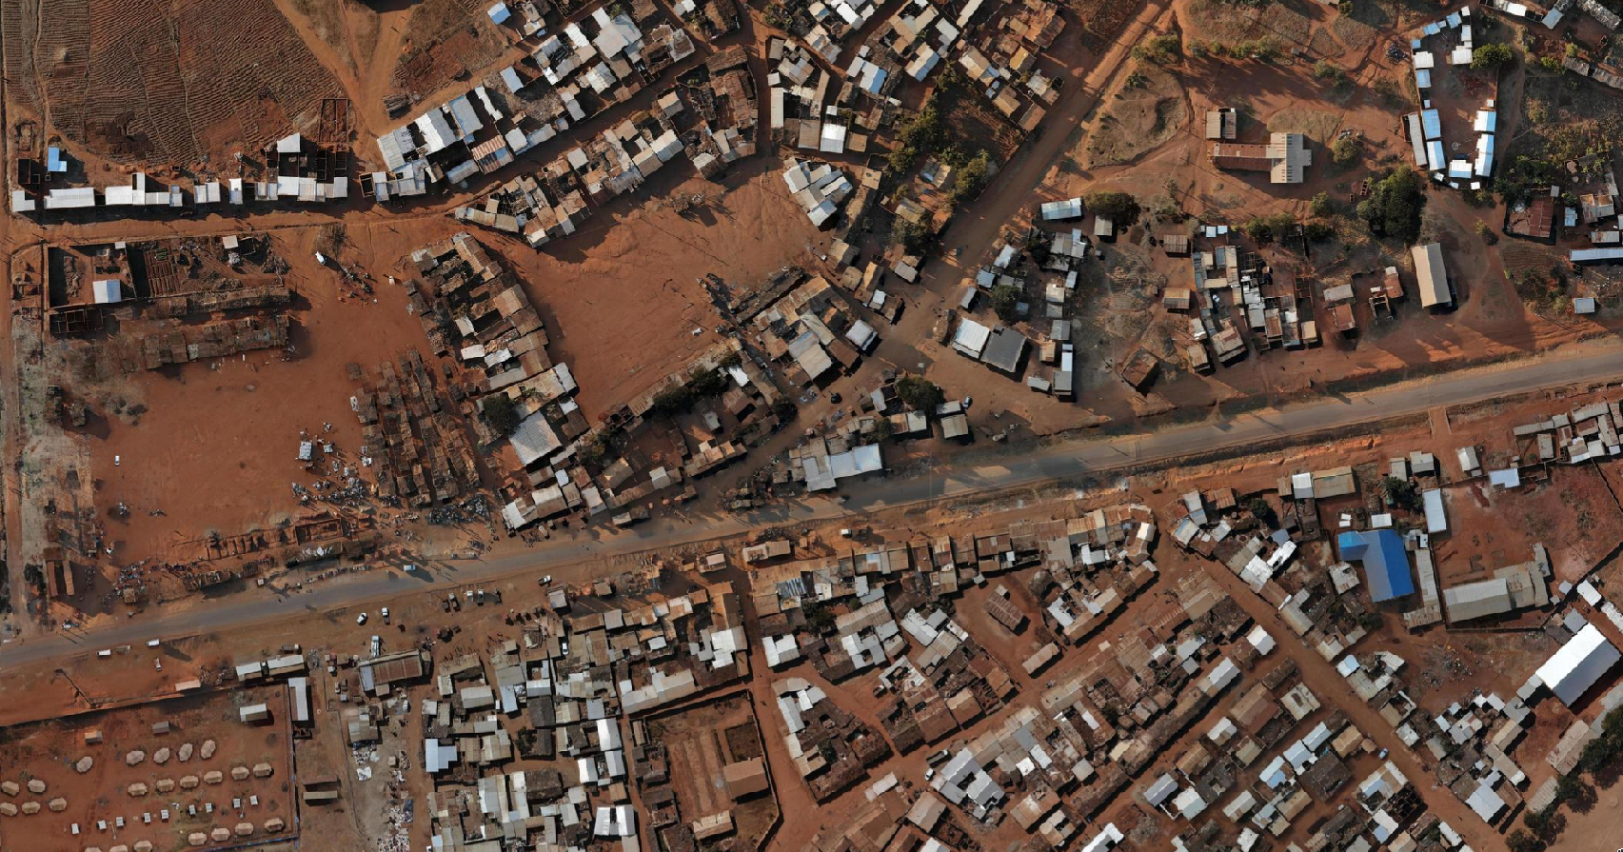
Dzaleka, Dowa, Malawi
Dzaleka, Dowa, Malawi

Slide 6
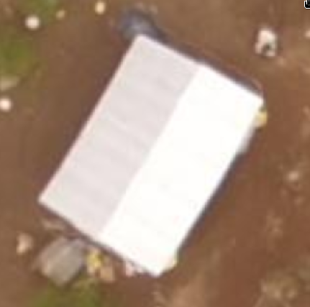
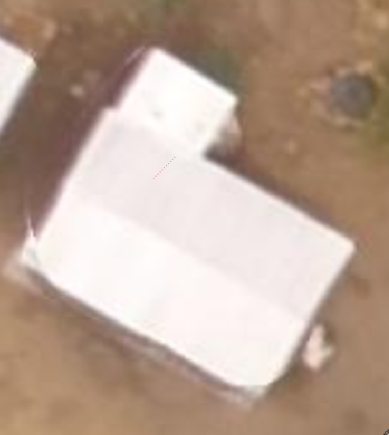
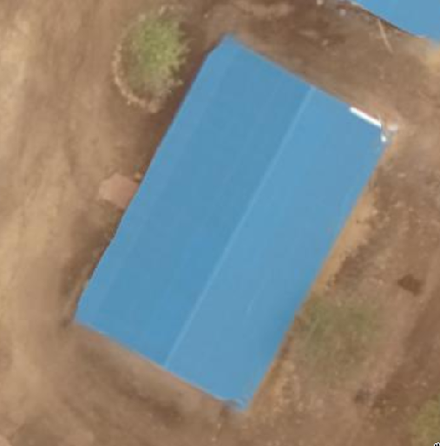
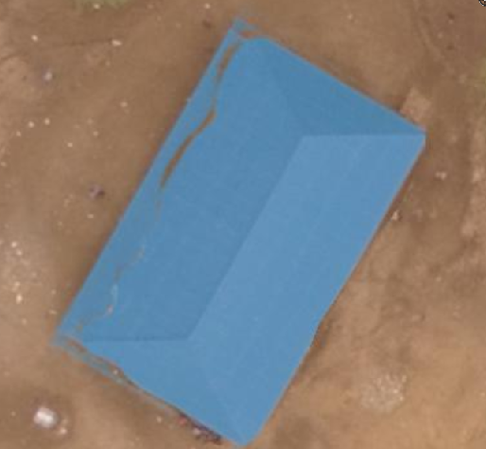
UAV motion artefacts
No Artefacts
With Artefacts

Slide 7
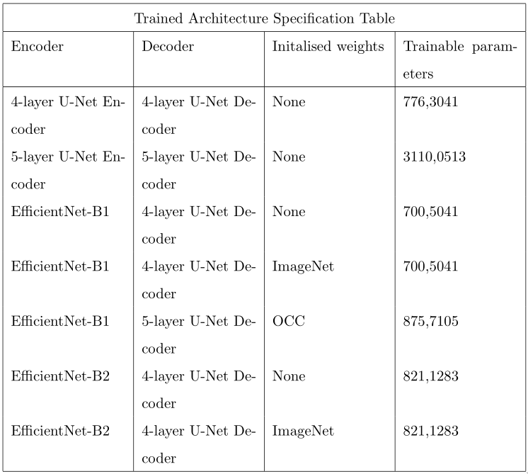
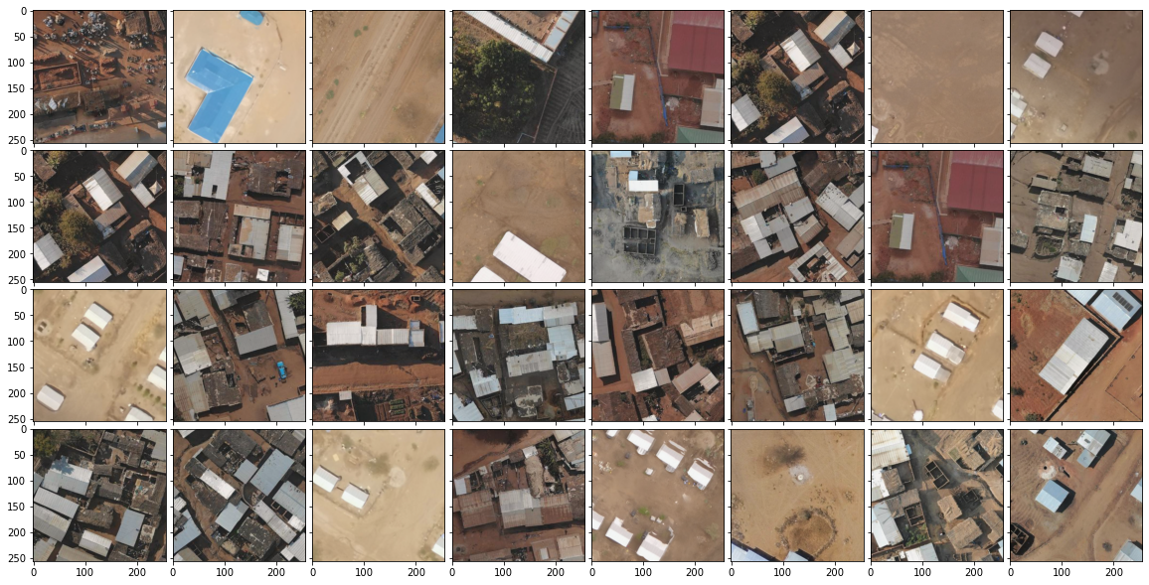
Experiment setup

Slide 8
Results

Slide 9
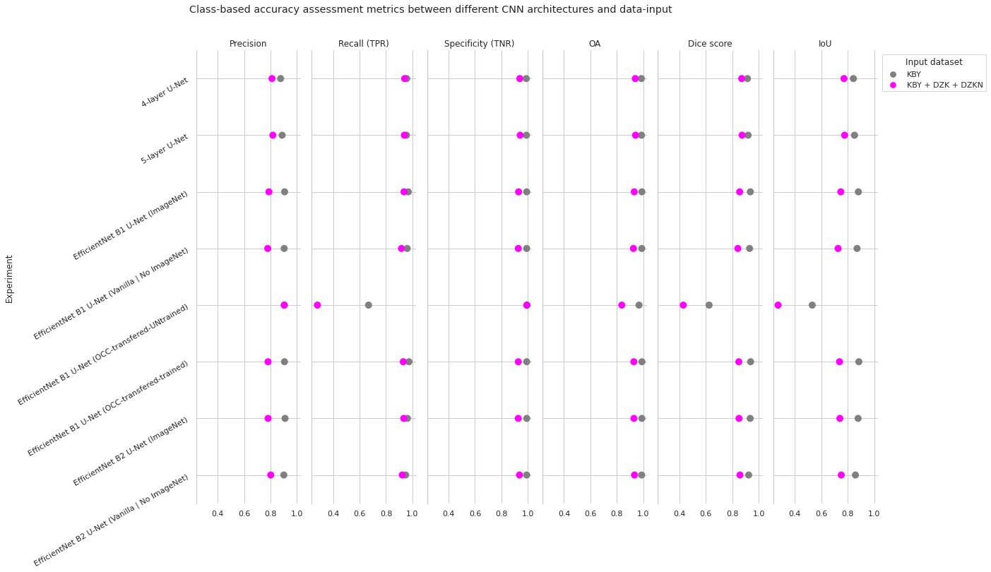
Results

Slide 10
Takeaways
Open UAV data can foster development of humanitarian AI-assisted mapping
Previous competition winning network experience difficultes in new environments
Investments in dedicated model provide better results

Slide 11
Questions?

